Slide 1
Digital histories workshop 5
visualisations

Slide 2
Visualising text: Old Bailey Online: Offences by crime category, 1674-1913, excluding ‘Theft’
and ‘Violent Theft’: 66,469 charges

Slide 3
Google books ngram viewer
http://searchengineland.com/when-ocr-goes-bad-googles-ngram-viewer-the-f-word-59181
Counting Words Often Goes Wrong
Does Google Books get the dates of some books wrong?
Is the distribution adjusted? IE, if you have more books in a particular year, can that cause some terms to spike?
Are the books “even” in subject matter? IE, do you have more scientific works scanned in one year than maybe another year?
Scanning Isn’t Perfect

Slide 4
There are several questions you want to ask yourself about any visualisation:
Can you interpret it?
What do the makers aim to do?
What sources does it use?
Does it actually add any information?
Can you manipulate it?
Is it visually appealing?

Slide 5
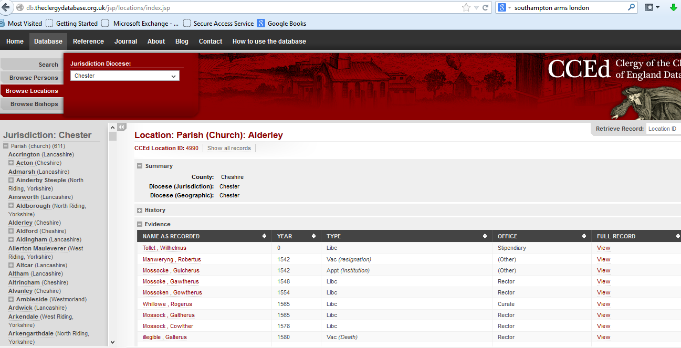
Types of visualisation: tabular

Slide 6
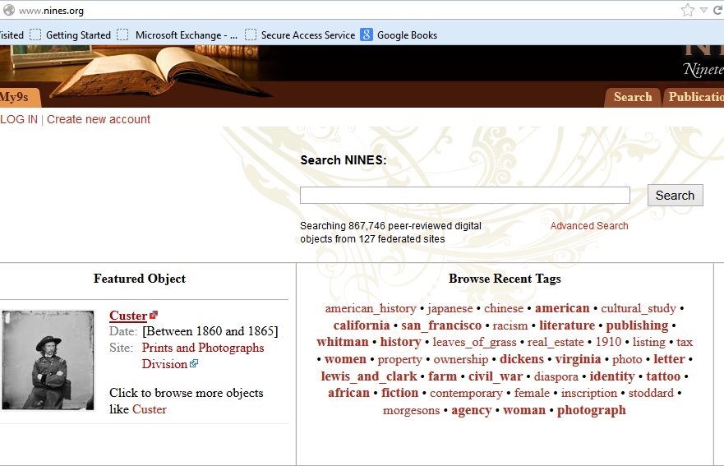
Types of visualisation: word cloud of tags

Slide 7
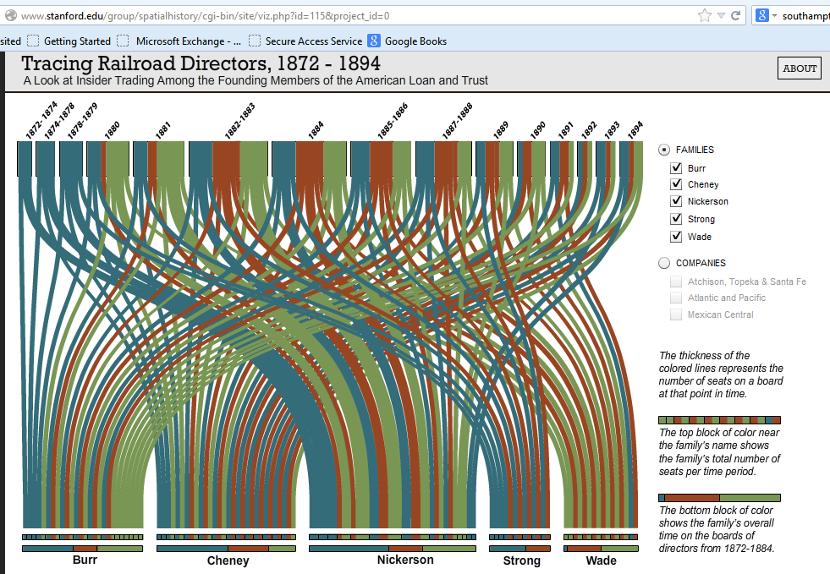
Types of visualisation: connections

Slide 8
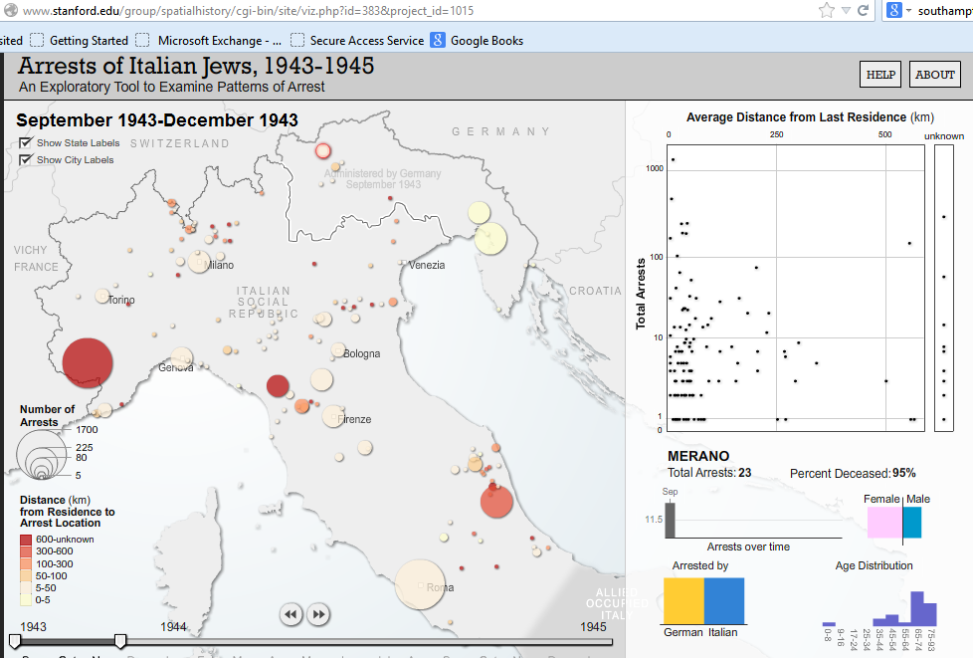
Types of visualisation: mapping by density

Slide 9
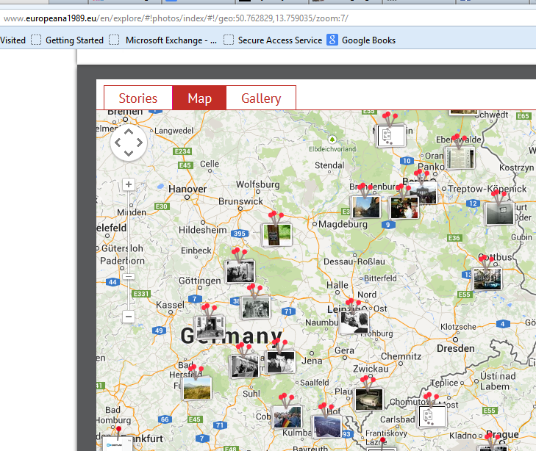
Types of visualisation – ‘pinning’ photographs

