Slide 1
Digital History
Workshop 2: searching
K. Navickas

Slide 2
Google advanced search
https://www.google.co.uk/advanced_search
= effectively similar to doing a BOOLEIAN search [“AND” “OR” “NOT”]

Slide 3
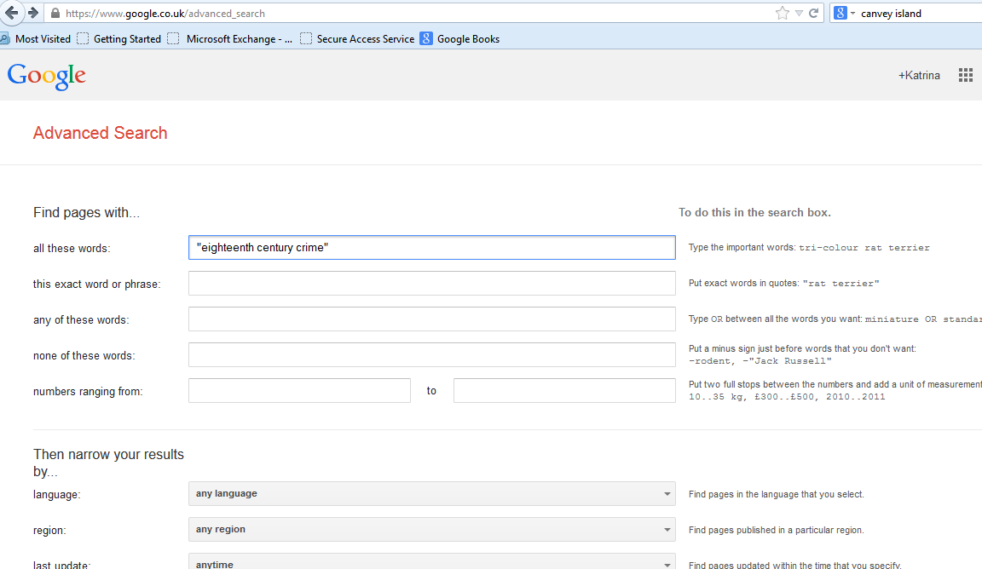
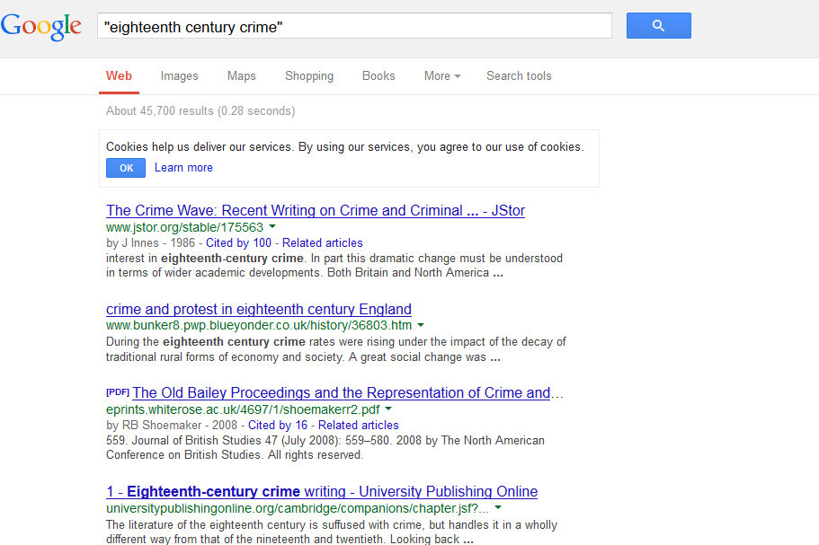

Slide 4
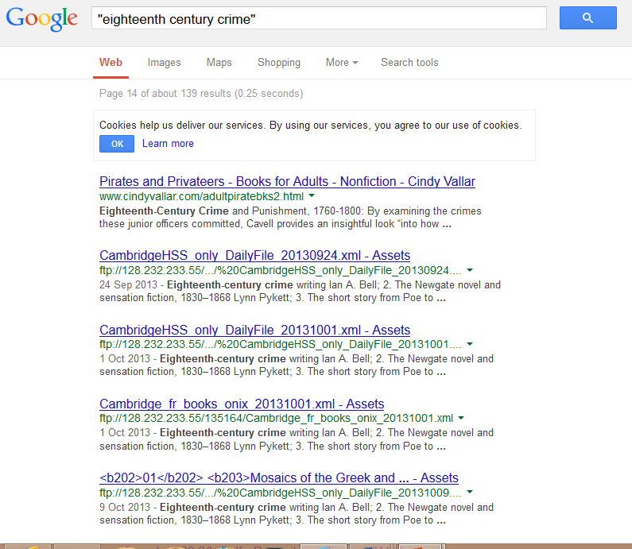

Slide 5
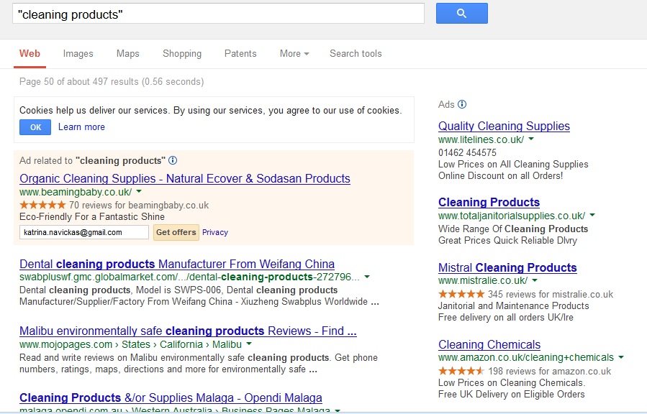

Slide 6
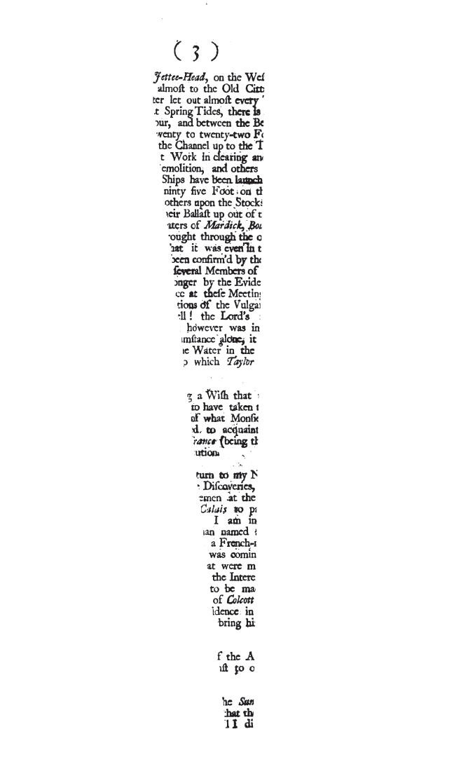
Google books
http://theartofgooglebooks.tumblr.com/
http://books.google.co.uk/books?id=n-9bAAAAQAAJ&dq=robin&pg=PT2&redir_esc=y#v=onepage&q&f=false

Slide 7
Google’s cataloguing of subjects
http://www.google.co.uk/search?tbo=p&tbm=bks&q=subject:%22history%22&num=10
Are all these books history books?
https://www.google.co.uk/search?tbo=p&tbm=bks&q=poverty+subject:%22history%22&num=10&lr=lang_en
Are all these books on the history of poverty?

Slide 8
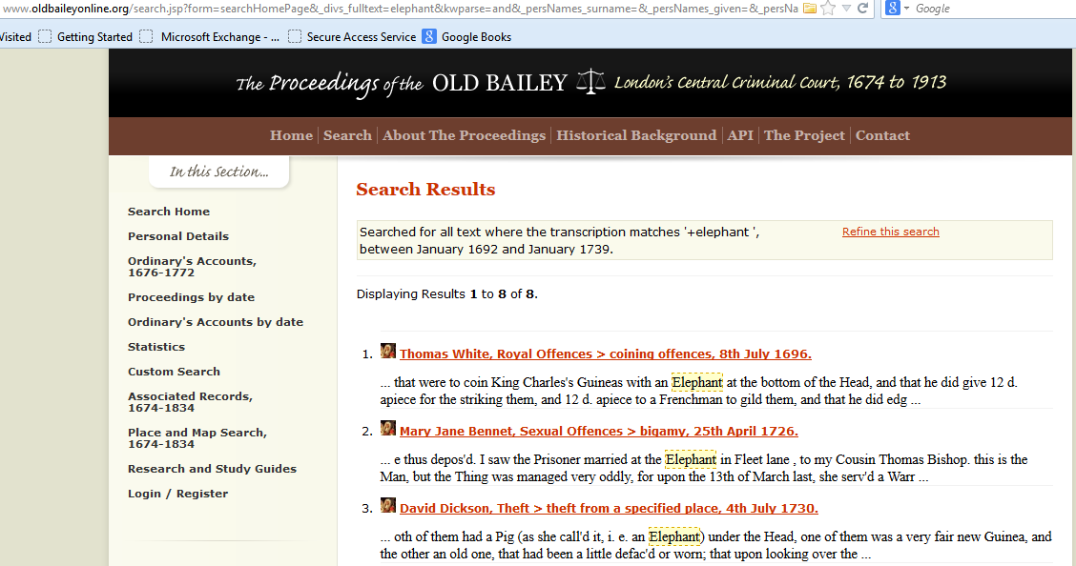
queries
http://www.oldbaileyonline.org/forms/formMain.jsp
Search for ‘elephant’ under keyword
url = http://www.oldbaileyonline.org/search.jsp?form=searchHomePage&_divs_fulltext=elephant&kwparse=and&_persNames_surname=&_persNames_given=&_persNames_alias=&_offences_offenceCategory_offenceSubcategory=&_verdicts_verdictCategory_verdictSubcategory=&_punishments_punishmentCategory_punishmentSubcategory=&_divs_div0Type_div1Type=&fromMonth=&fromYear=&toMonth=&toYear=&ref=&submit.x=0&submit.y=0

Slide 9
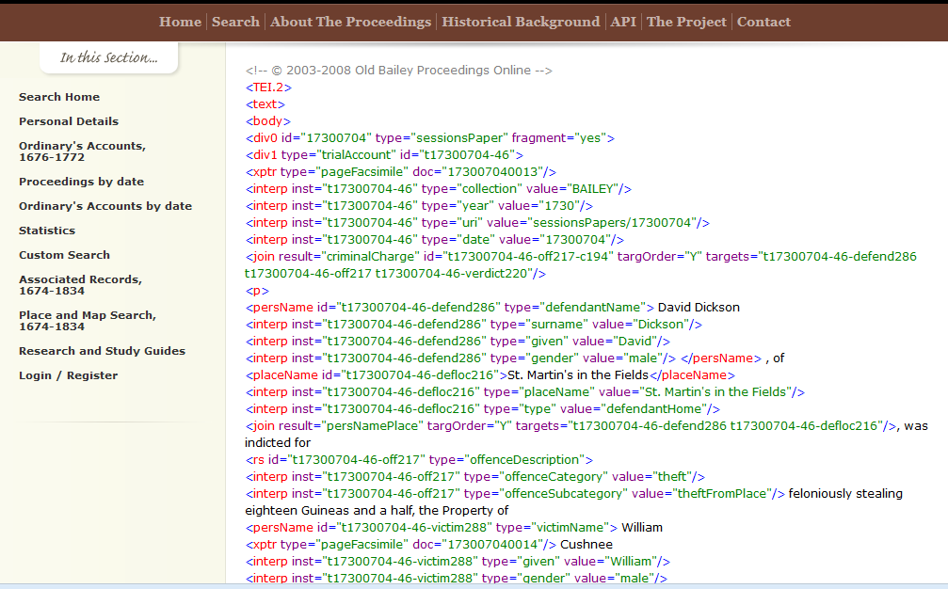
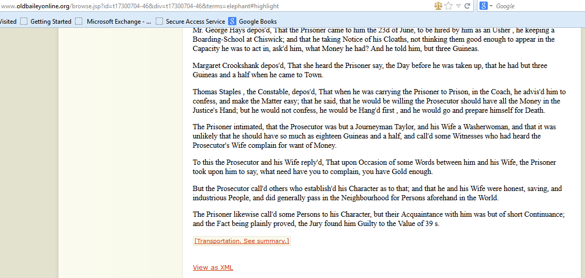
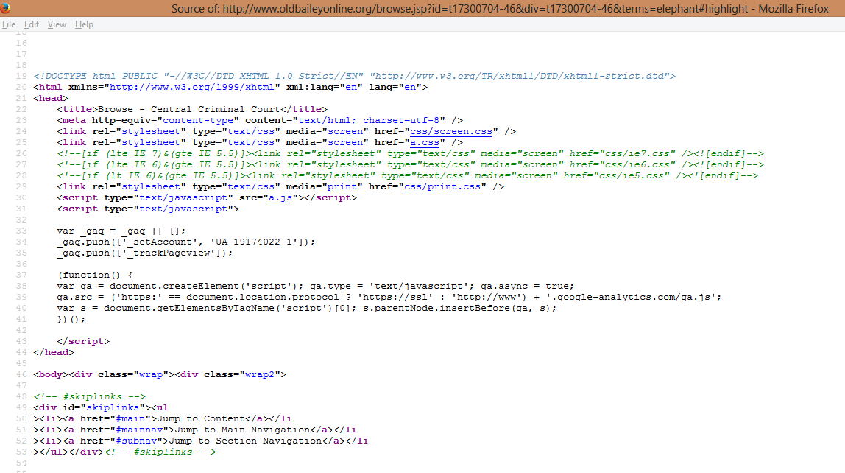
View page source and html or xml

