Slide 1
6HUM1012 lecture 7: Chartism

Slide 2
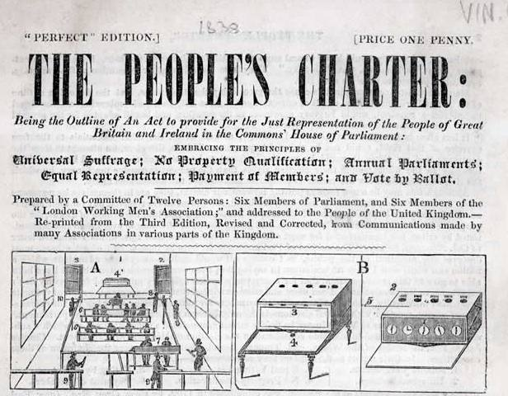
The People’s Charter, 1838
http://www.bl.uk/onlinegallery/takingliberties/staritems/159peoplescharterpic.html

Slide 3
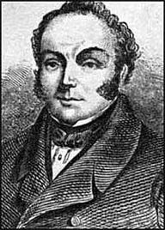
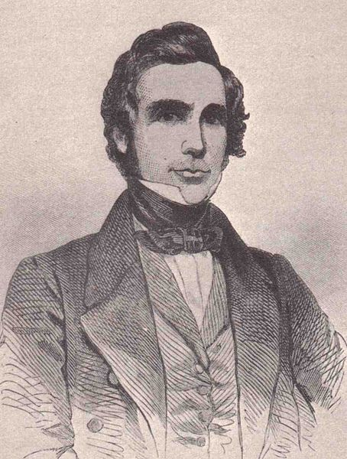
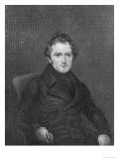
Some Chartist leaders
James Bronterre O’Brien
(1805-1864)
Feargus O’Connor (1794-1855)
William Lovett (1800-1877)

Slide 4
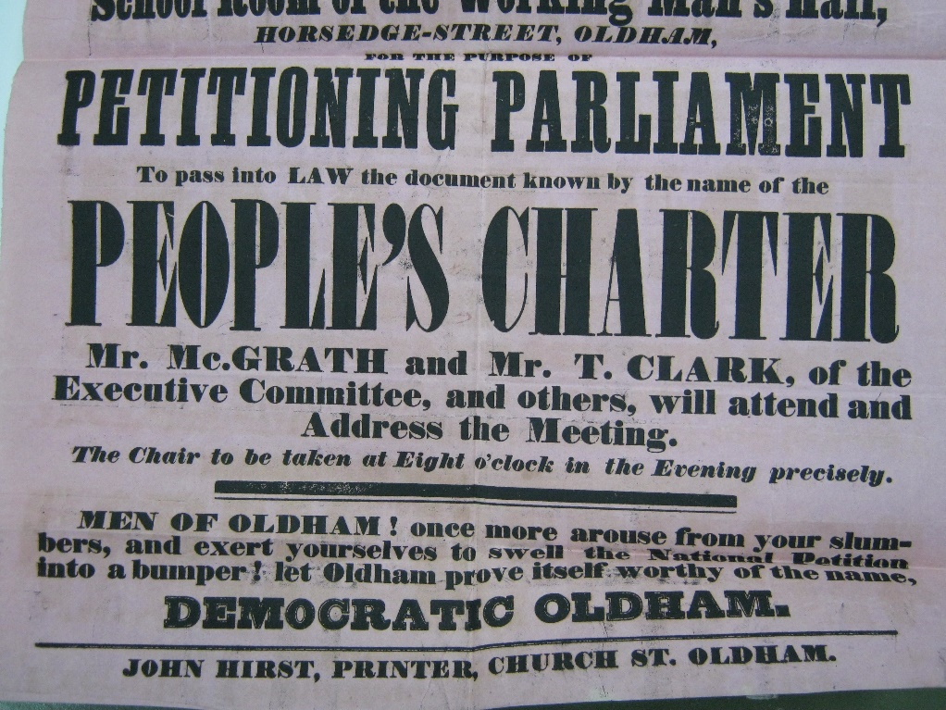
Posters for Chartist meetings, 1846-8

Slide 5
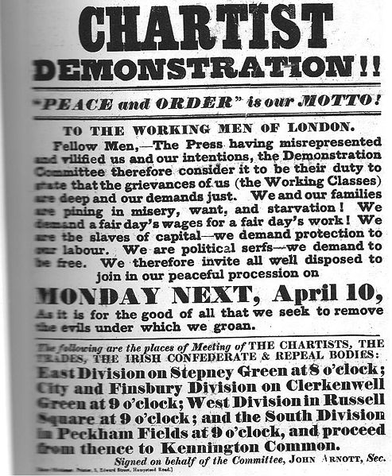
Kennington Common, 10 April 1848

Slide 6
Joseph Rayner Stephens, speech at Kersal Moor ‘monster meeting’, Manchester, 24 September 1838
‘This question of Universal Suffrage was a knife and fork question... and if any man asked him what he meant by Universal Suffrage, he would answer, that every working man in the land had a right to have a good coat to his back, a comfortable abode in which to shelter himself and his family, a good dinner upon his table, and no more work than was necessary for keeping him in health, and as much wages for that work as would keep him in plenty, and afford him the enjoyment of all the blessings of life which a reasonable man could desire. (Tremendous cheers).

Slide 7
Malcolm Chase, Chartism: a New History, p. 10
Hunger however does not readily translate into a sustained political movement, supported by a dedicated press and its own professional agents and lecturers, and for the most part distinguished by self-restraint and discipline. Yet this is exactly what Chartism was.

Slide 8
http://www.bl.uk/learning/artimages/maphist/wealth/oconnorville/chartist.html

Slide 9
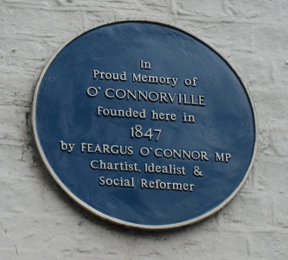
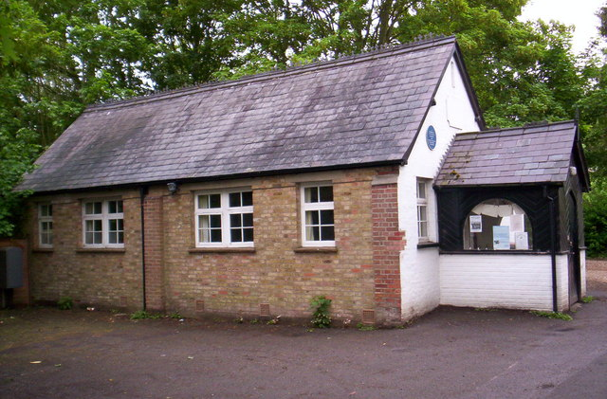
Chartist Land Plan: O’Connorville, Heronsgate, Herts (1847-1857)
http://www.geograph.org.uk/photo/435703

Slide 10
Gareth Stedman Jones, ‘Rethinking Chartism’, in Languages of Class. Studies in English working class history (1983), p.168
As a secular phenomenon, Chartism was the last, most prominent and most desperate – though not perhaps the most revolutionary – version of a radical critique of society, which had enjoyed an almost continuous existence since the 1760s and 1770s. The vision which lay behind this critique was of a more or less egalitarian society, populated exclusively by the industrious, and needing minimal government.
Political power, as Chartists conceived it, in line with eighteenth century radicals, was essentially a negative phenomenon, the freedom from present oppressions and the legal or legislative prevention of their recurrence.

Slide 11
debate
Chartism did not succeed because the movement had too many aims and tactics.

