Slide 1
6HUM1012 Protest, Riot, Reform
Lecture 6: Trade Unions and Combinations

Slide 2
Trade Unions strove to:
Defend interests of skilled male workers:
Against women and children (unskilled casual labour)
Against laissez-faire free-trade capitalism (repeal of wage-fixing legislation and apprenticeship clauses; deterioration in working conditions; introduction of machinery)

Slide 3
Trade unions, c.1780-1850
Not nationally organised – no long-term national executive committees – locally or regionally based
Not the only means of working-class organisation – importance of apolitical friendly societies and other forms of action
Not every worker was active in trade unionism

Slide 4
Context and key dates
Regional nature of industrialisation
1799 and 1800 Combination Acts
Cotton Arbitration Act 1800
1812 Frame Breakers’ Act
1813-14 – wage fixing legislation and the 1563 (Elizabethan) Statute of Artificers repealed
1823 – Master and Servant Act
1824-5 – Combination Acts repealed
1834 – Grand National Consolidated Trades Union formed
24 February 1834 – Tolpuddle ‘martyrs’ arrested
24 March 1834 – Grand Meeting of the Working Classes
21 April 1834 – Copenhagen Fields demonstration
August 1842 – General Strike; ‘plug plots’

Slide 5
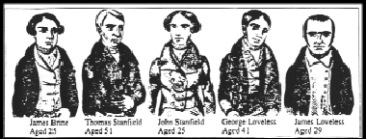
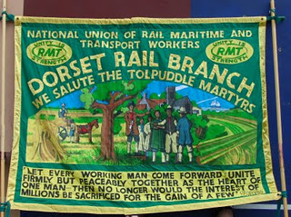
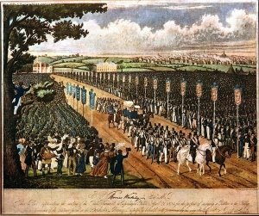
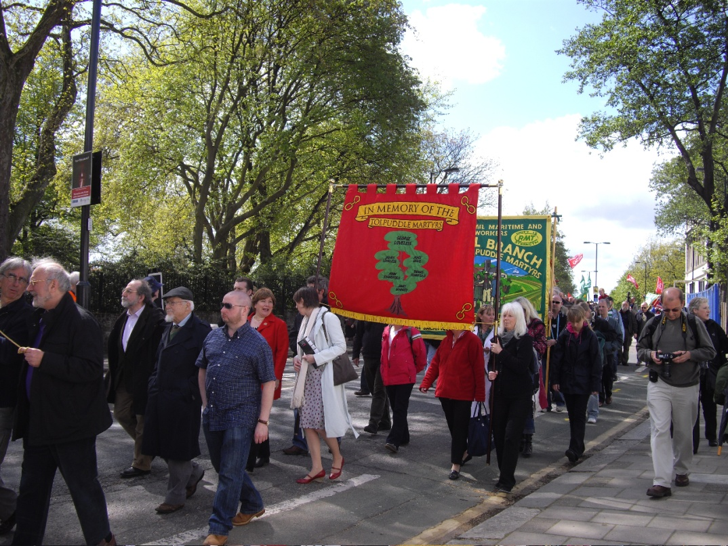
Tolpuddle Martyrs 1834
Copenhagen Fields demonstration, 21 April 1834
Tolpuddle festival 2009

Slide 6
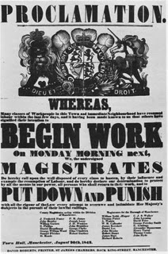
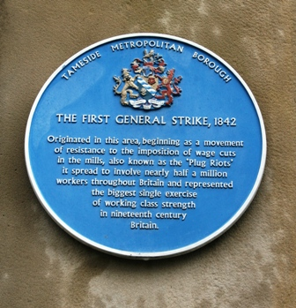
General Strike or the ‘Plug Plots’ August 1842
Blue plaque in Stalybridge, Cheshire
Warning notice, Manchester, 20 August 1842

Slide 7
Historiography
Trade union movement and the Labour party – Fabian – 1919 – J.L. and B. Hammond, The Skilled Labourer, 1760-1832; and Sidney and Beatrice Webb, The History of Trade Unionism
Marxist interpretations
E.P. Thompson, The Making of the English Working Class (1963)
Newer interpretations – Malcolm Chase, John Rule, Adrian Randall

Slide 8
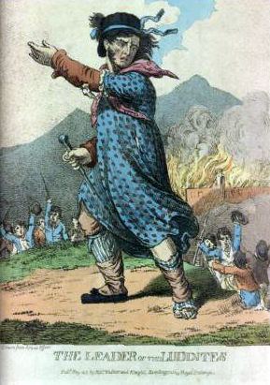
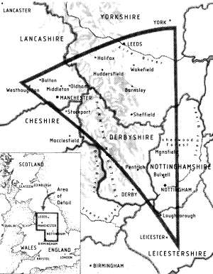
Luddites (1811-12)

