Slide 1
6HUM1012 Popular Protest, Riot, and Reform
Dr Katrina Navickas
Lecture 1: types of collective action and protest

Slide 2
definitions
Popular protest
Popular politics
Collective action
‘Contentious gatherings’
Movement
Social movement
riot
Reform
Radical
Trade union – organised labour

Slide 3
Types of collective action and protest
Types of action
Types of campaign

Slide 4
Basic timeline
1763-1774 – John Wilkes’ campaign for ‘liberty’
1776-1784 – American revolutionary war – association movement for reform
1789 – start of French Revolution
1790s – French war - radical and corresponding societies – working-class; influenced by Thomas Paine
1798 – Irish Rebellion and 1801 Union
1802-1815 – Napoleonic Wars
1811-12 – Luddite machine breaking
1816-20 – ‘mass platform’ radicalism
August 1819 – Peterloo Massacre, Manchester
1830-32 – political unions and the 1832 Reform Act
1830-33 – Swing riots
1834 – Tolpuddle martyrs
1834-39 – anti- New Poor Law campaign
1837-1848 – Chartism
1838-1846 – Anti-Corn Law League

Slide 5
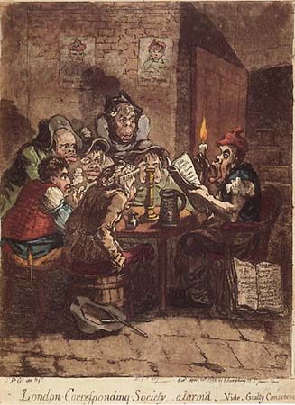
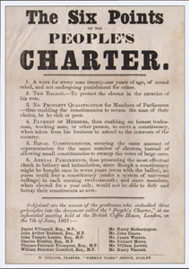
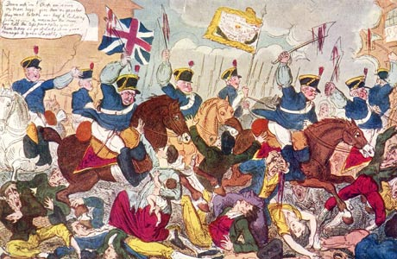
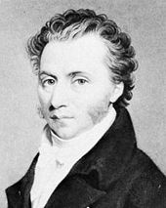
Parliamentary reform movements
Corresponding societies
of the 1790s
Chartism, 1837-1848
Christopher Wyvill and the Association movement,
1780-1785
John Wilkes
and the Wilkesites
1763-1774
Political unions and the reform campaign, 1830-32
The ‘mass platform’ radical movement of 1816-1820

Slide 6
Warning:
Avoid a Whiggish teleology – there was no inevitable march to democracy.

Slide 7
legislation
1715 Riot Act
1792 – royal proclamation against seditious writings
1794 – treason trials
1794 suspension of Habeas Corpus
Nov 1795 ‘Two Acts’ (‘Gagging Acts’)
1799 and 1800 Combination Acts
1817 suspension of Habeas Corpus
Nov-Dec 1819 ‘Six Acts’
1830 – 19 Swing rioters hanged and hundreds transported
1839 – third royal proclamation against seditious meetings. 500 Chartists arrested, 250 imprisoned and 6 death sentences commuted to life transportation.
1842 – 200 transportations of ‘plug rioters’ and Chartists

Slide 8
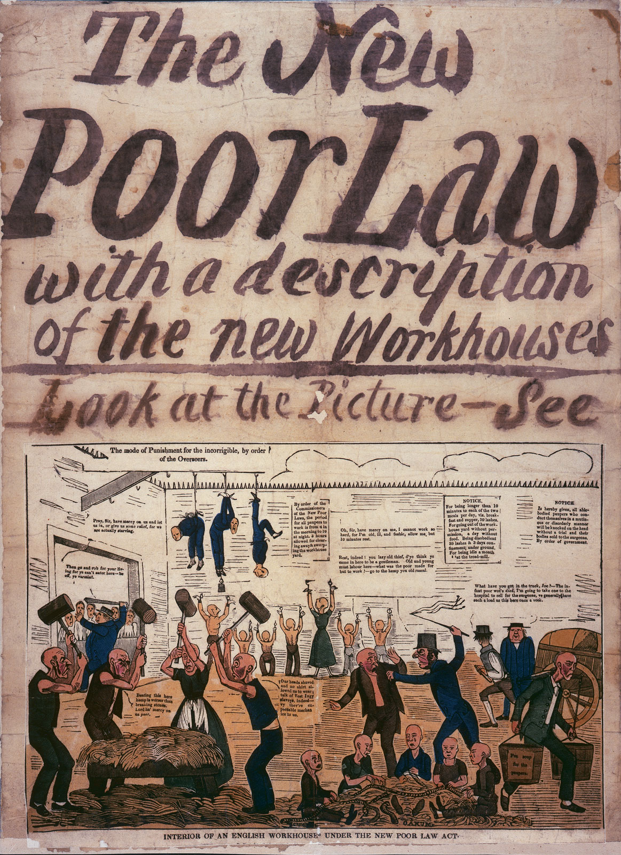
Single issue campaigns
Anti-New Poor Law, 1834-39
Anti-Corn Law League, 1838-46
Anti-Slave trade to 1807, anti-slavery to 1833

Slide 9
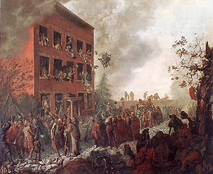
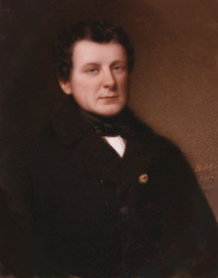
Religious collective action
Church and King riots, 1791-2
Gordon Riots, June 1780
Catholic committee and United Irishmen in the 1790s
Daniel O’Connell’s repeal movement in the 1820s and 30s

Slide 10
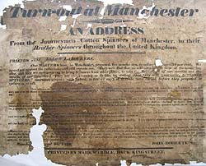
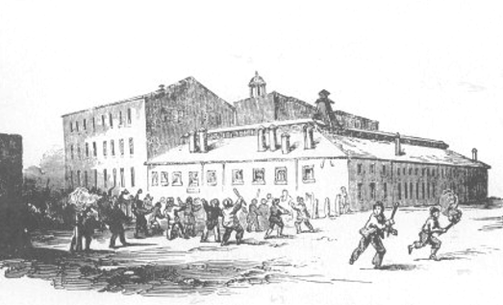
Industrial collective action
Strikes and trade unions
Luddism, 1811-12
‘Plug Plots’, 1842

Slide 11
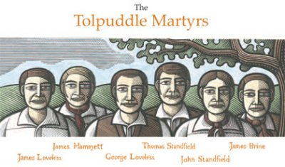
Agricultural collective action
Tolpuddle Martyrs, 1834
Swing riots, 1830-33

Slide 12
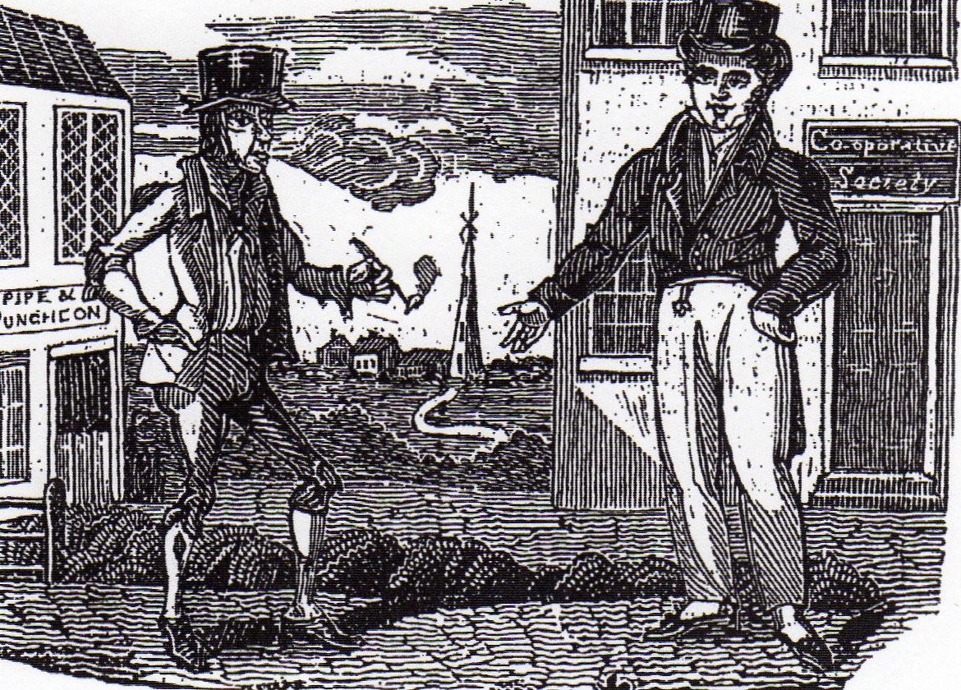
Other forms of collective action
Food riots
Enclosure riots
Anti-impressment riots
Owenite socialism

Slide 13
Charles Tilly, Popular Contention in Great Britain 1758-1834 (1995), pp. 44-6
Eighteenth century contentious gatherings
Parochial – issues often confined to one community
Violent direct action enacted locally but redress from national bodies sought through intermediary authorities
Nineteenth century collective action
National – issues affect many communities, or affected power centres that controlled many localities
‘modular ‘ – forms of action easily transferable methods between localities
Particular – forms of action vary between localities and do not spread easily
‘autonomous’ – address centres of power directly

