Slide 1
Peace, Power and Prosperity: Lecture 12
Britain on the eve of war

Slide 2
Structure of the lecture:
Summary of changes and continuities, 1789-1914:
politics and representation
the town, the country, and religion
the United Kingdom
empire
society and welfare
women and the family
- the Edwardian crisis?

Slide 3
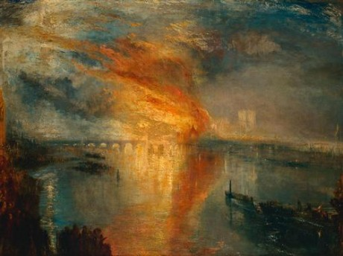
Politics and representation
Three reform acts 1832, 1867, 1884/5
Parliament Act 1911
Disintegration of old party boundaries and the rise of the Labour party
JML Turner, ‘The Burning of the Houses
of Lords and Commons, 1835

Slide 4
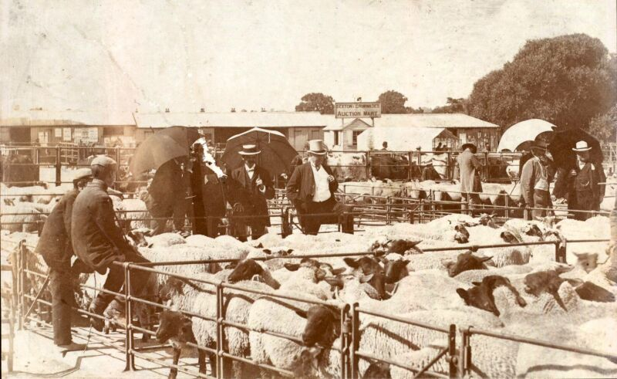
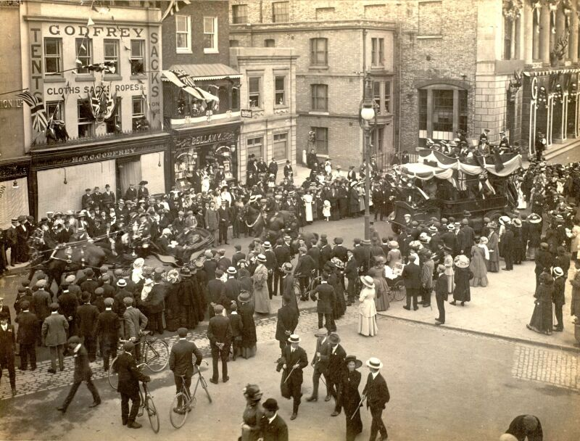
Town, Country, and religion http://www.esds.ac.uk/qualidata/online/data/edwardians/photogallery.asp
Livestock being surveyed at a rural cattle and sheep auction, Colchester.
Crowds gather for Coronation celebrations, Tindal Square, Chelmsford, 1911.

Slide 5
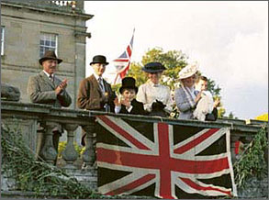
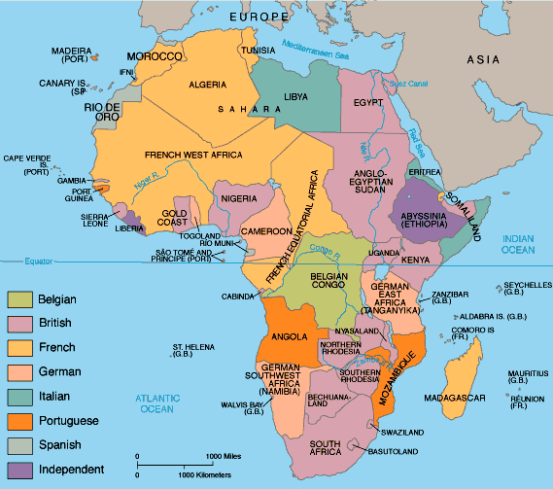
The United Kingdom and empire
Africa, 1914

Slide 6
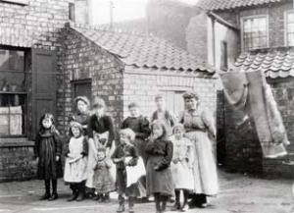
Society and welfare
Adults and children living in York slums, circa 1900 Picture: Joseph Rowntree Foundation.

Slide 7
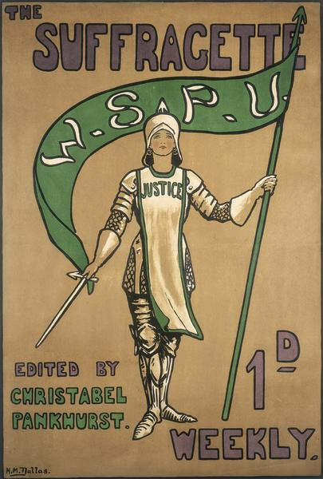
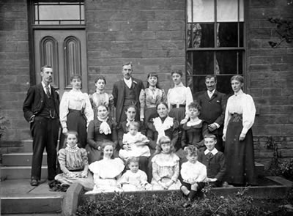
Family and women
Portrait of an unknown family in Wakefield, around 1905, Wakefield Museum.
Suffragette magazine, 1910,
London Museum

Slide 8
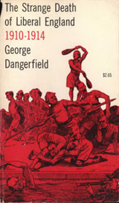
Edwardian crisis?
Exaggeration by the Conservatives defeated in 1906?
George Dangerfield, The Strange Death of Liberal England (1935)
Liberal dominance until 1918?
Labour weakness

