Slide 1
5HUM0271 lecture 2: The “long eighteenth century”: historians’ overviews
Katrina Navickas

Slide 2
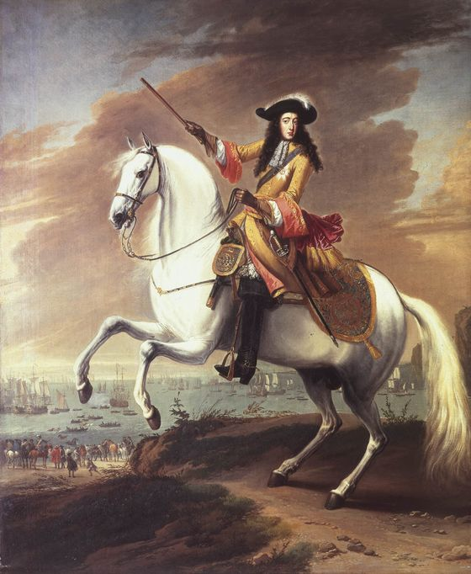
Key political dates of the ‘long eighteenth century’ – ‘Glorious Revolution’
1688 Glorious Revolution – 5 November
1689 Bill of Rights
1694 founding of the Bank of England
1701 Act of Settlement
William of Orange landing at Torbay, 5 November 1688

Slide 3
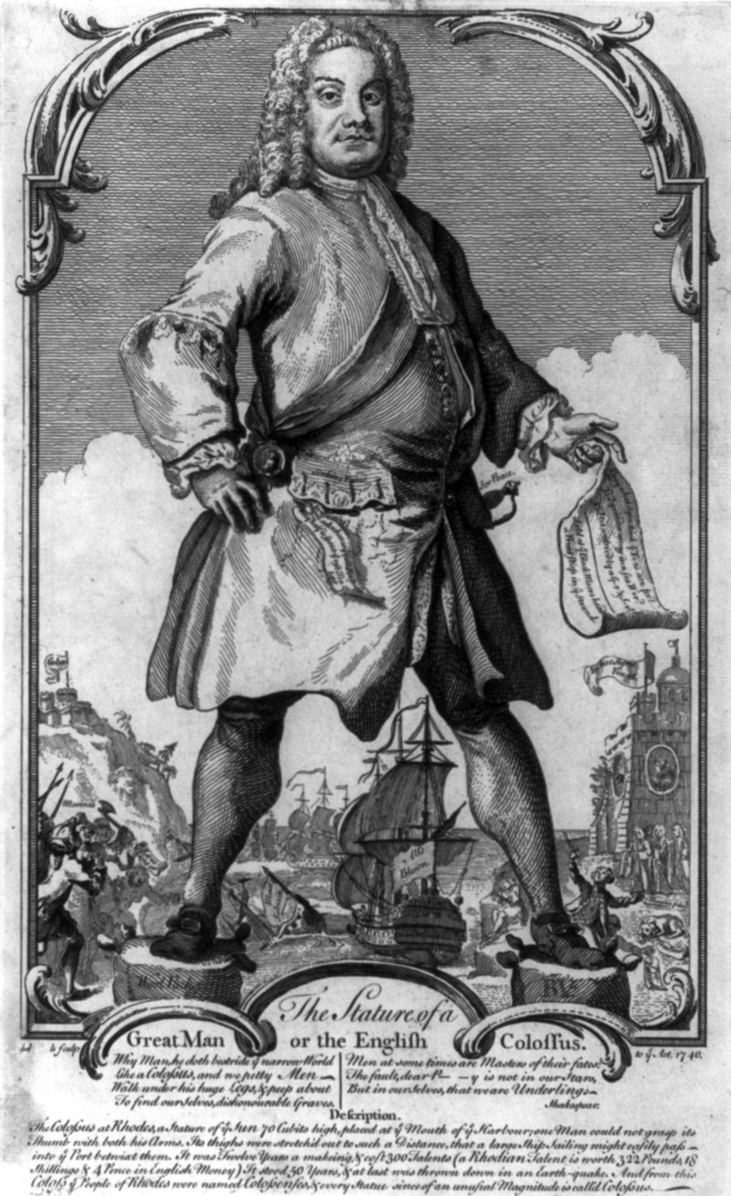
Key political dates of the ‘long eighteenth century’ – ‘Whig oligarchy’
1721-42 – prime ministership of Sir Robert Walpole
1715 and 1745 Jacobite rebellions
Walpole, the English Colossus

Slide 4
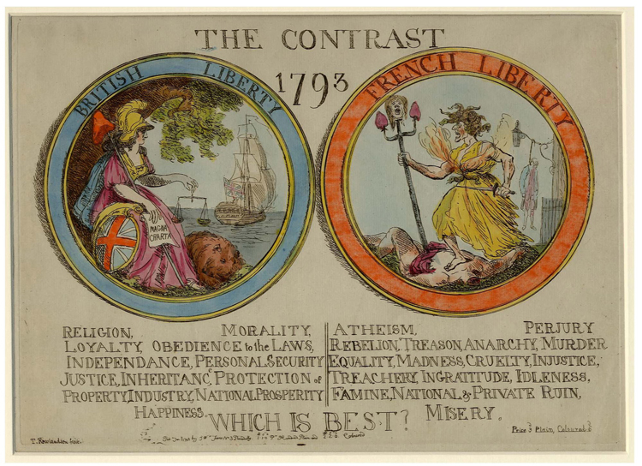
Key political dates of the ‘long eighteenth century’ = reform and revolution
1754-63 – Seven Years’ War
1760 – accession of George III
1776 – American revolution (war with America 1775-83)
1789 – French revolution (war with France 1793-1815)
1832 – Reform Act

Slide 5
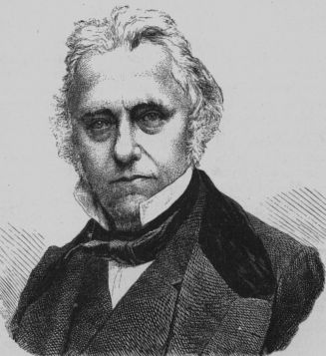
19th century Whig historians such as T.B. Macaulay (1800-59)
The History of England from the Accession of James the Second
(1848)
http://www.gutenberg.org/ebooks/1468
Characteristics of Whig history:
Whig principles = ‘balanced constitution’
Celebration of 1832 Reform Act
Political & constitutional
Characteristics of Whiggish history:
Belief in progress
Anglocentric & imperialist

Slide 6
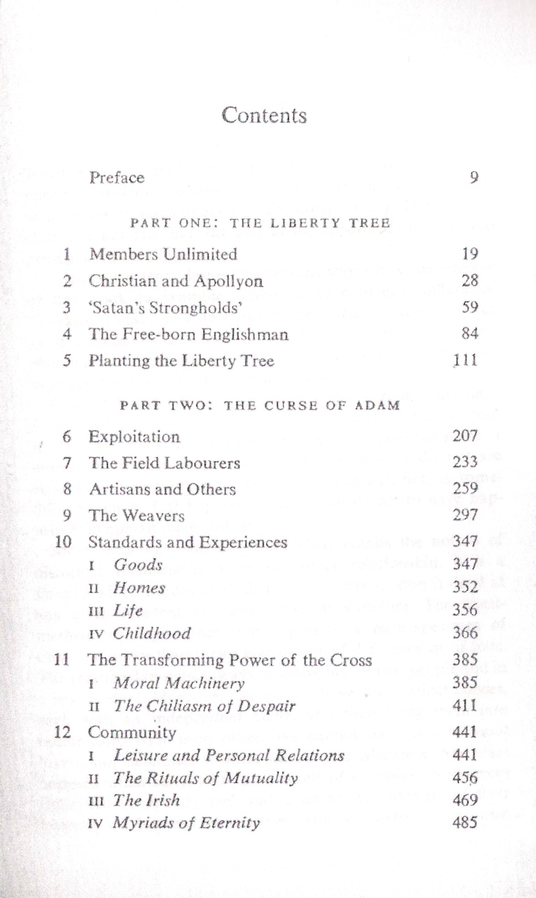
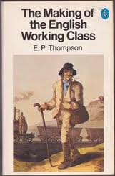
‘History from below’ and social history E.P. Thompson, The Making of the English Working Class (Harmondsworth, 1963; 1968 rev.ed)

Slide 7
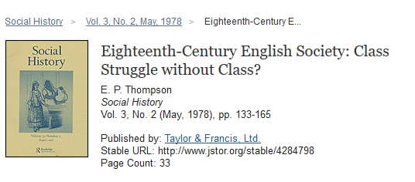
E. P. Thompson – challenging traditional Marxist interpretations
Plebeians versus patricians
Class as a process not as an economic category

Slide 8
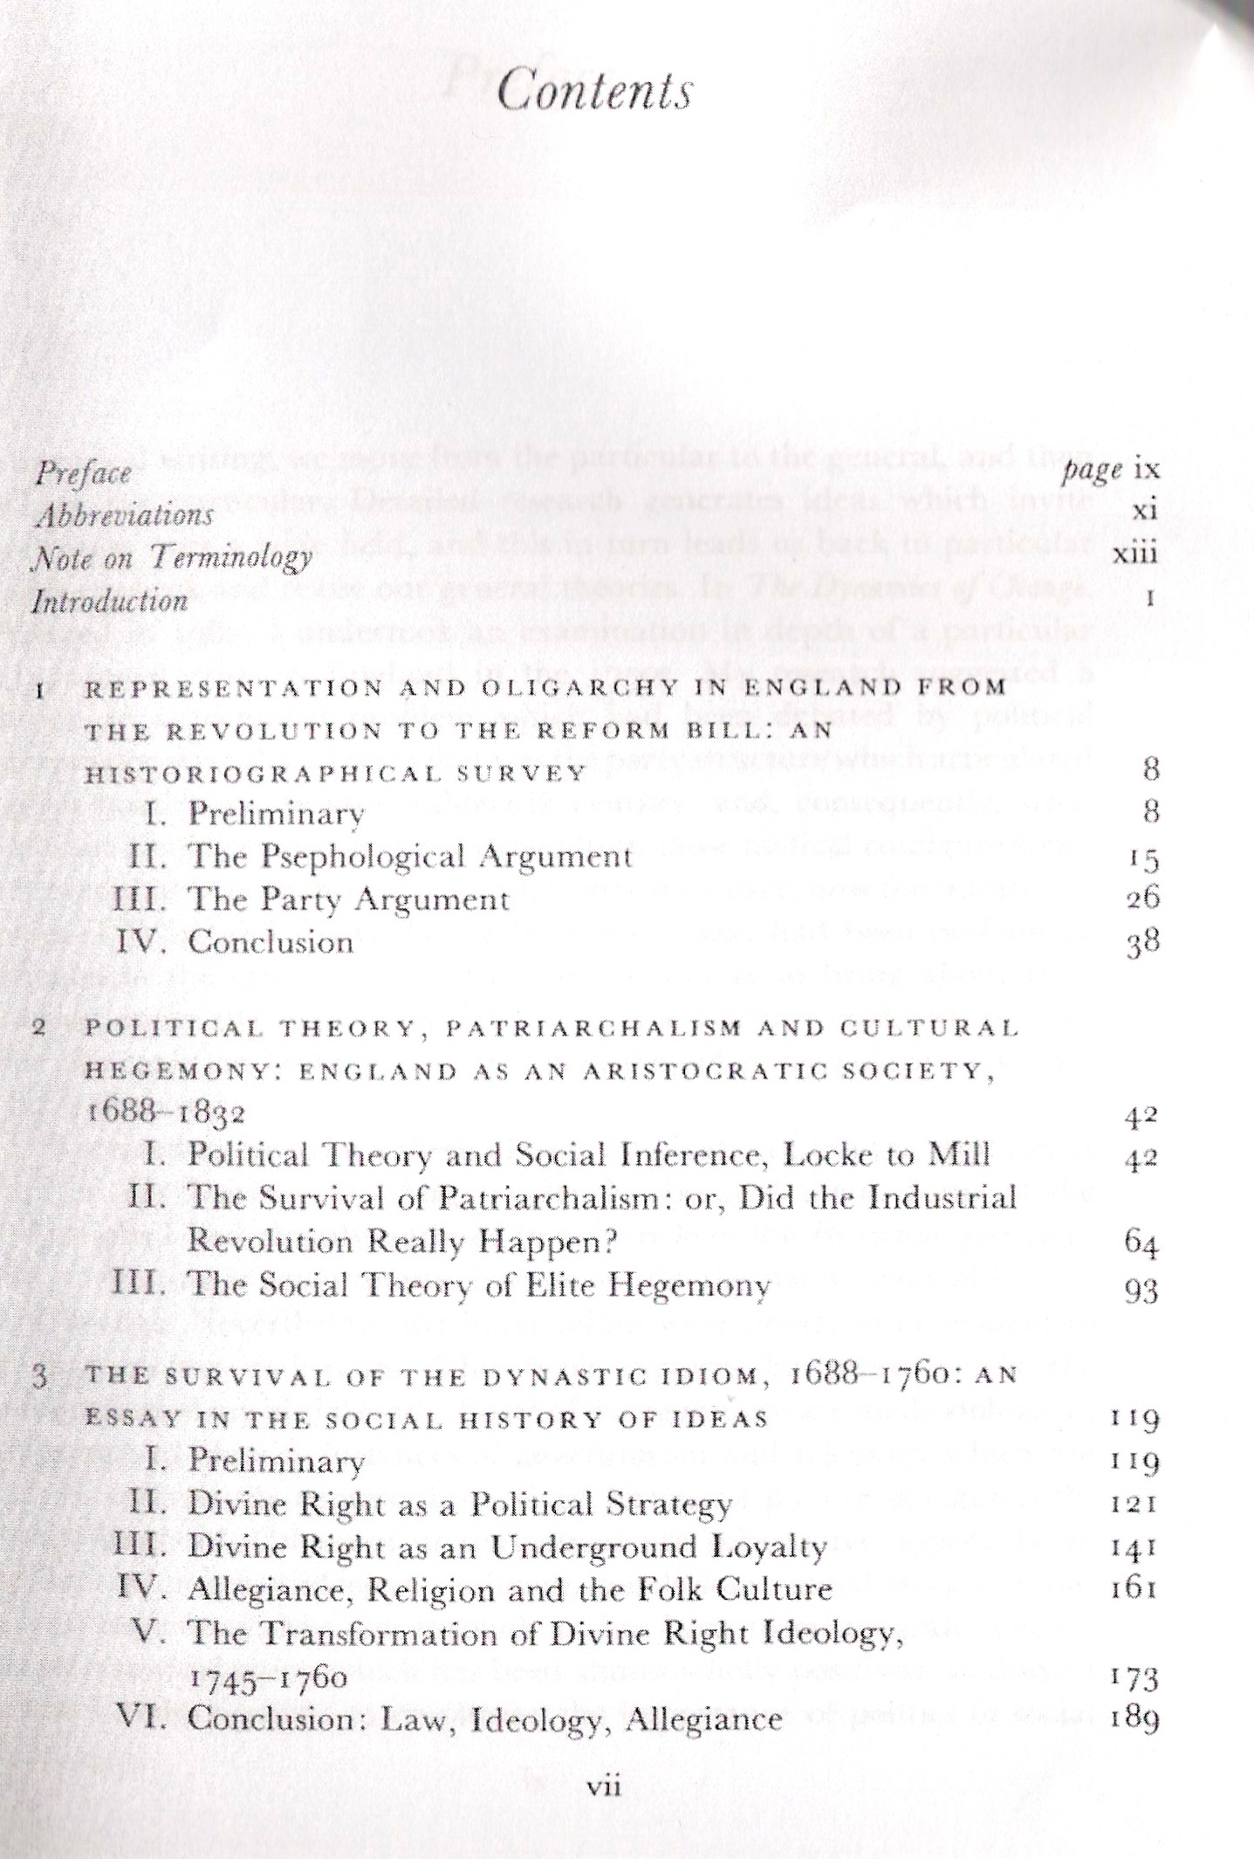
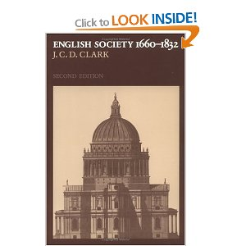
J.C.D. Clark, English Society, 1660-1832: Religion, Ideology and Politics during the Ancien Régime: Religion, Ideology and Politics During the Ancien Regime (Cambridge, 1985)

Slide 9
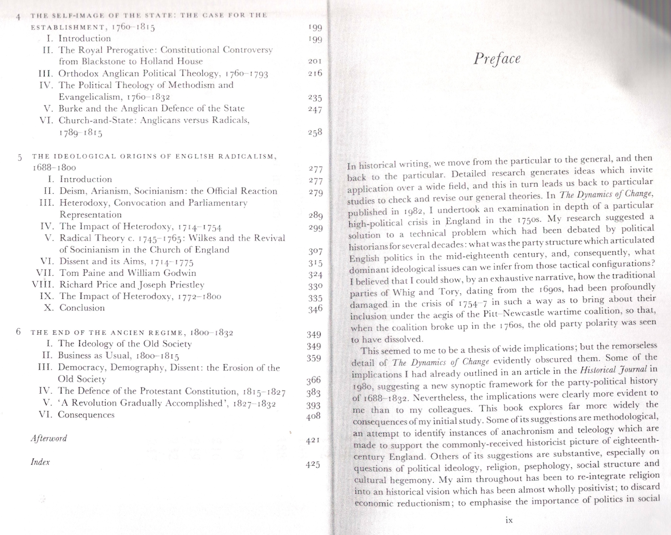

Slide 10
Paul Langford, A Polite and Commercial People: England, 1727-1783 (Oxford, 1992)

Slide 11
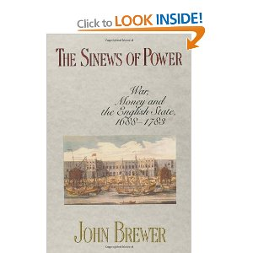
John Brewer, The Sinews of Power: War, Money and the English State, 1688-1783 (Harvard, 1990)
‘fiscal-military state’
Structuralist –
return to a Whiggish view?

Slide 12
Linda Colley, Britons: Forging the Nation, 1707-1837 (New Haven, 1992)

Slide 13
Other books we will be examining in the seminar ‘speed historiography’

Slide 14
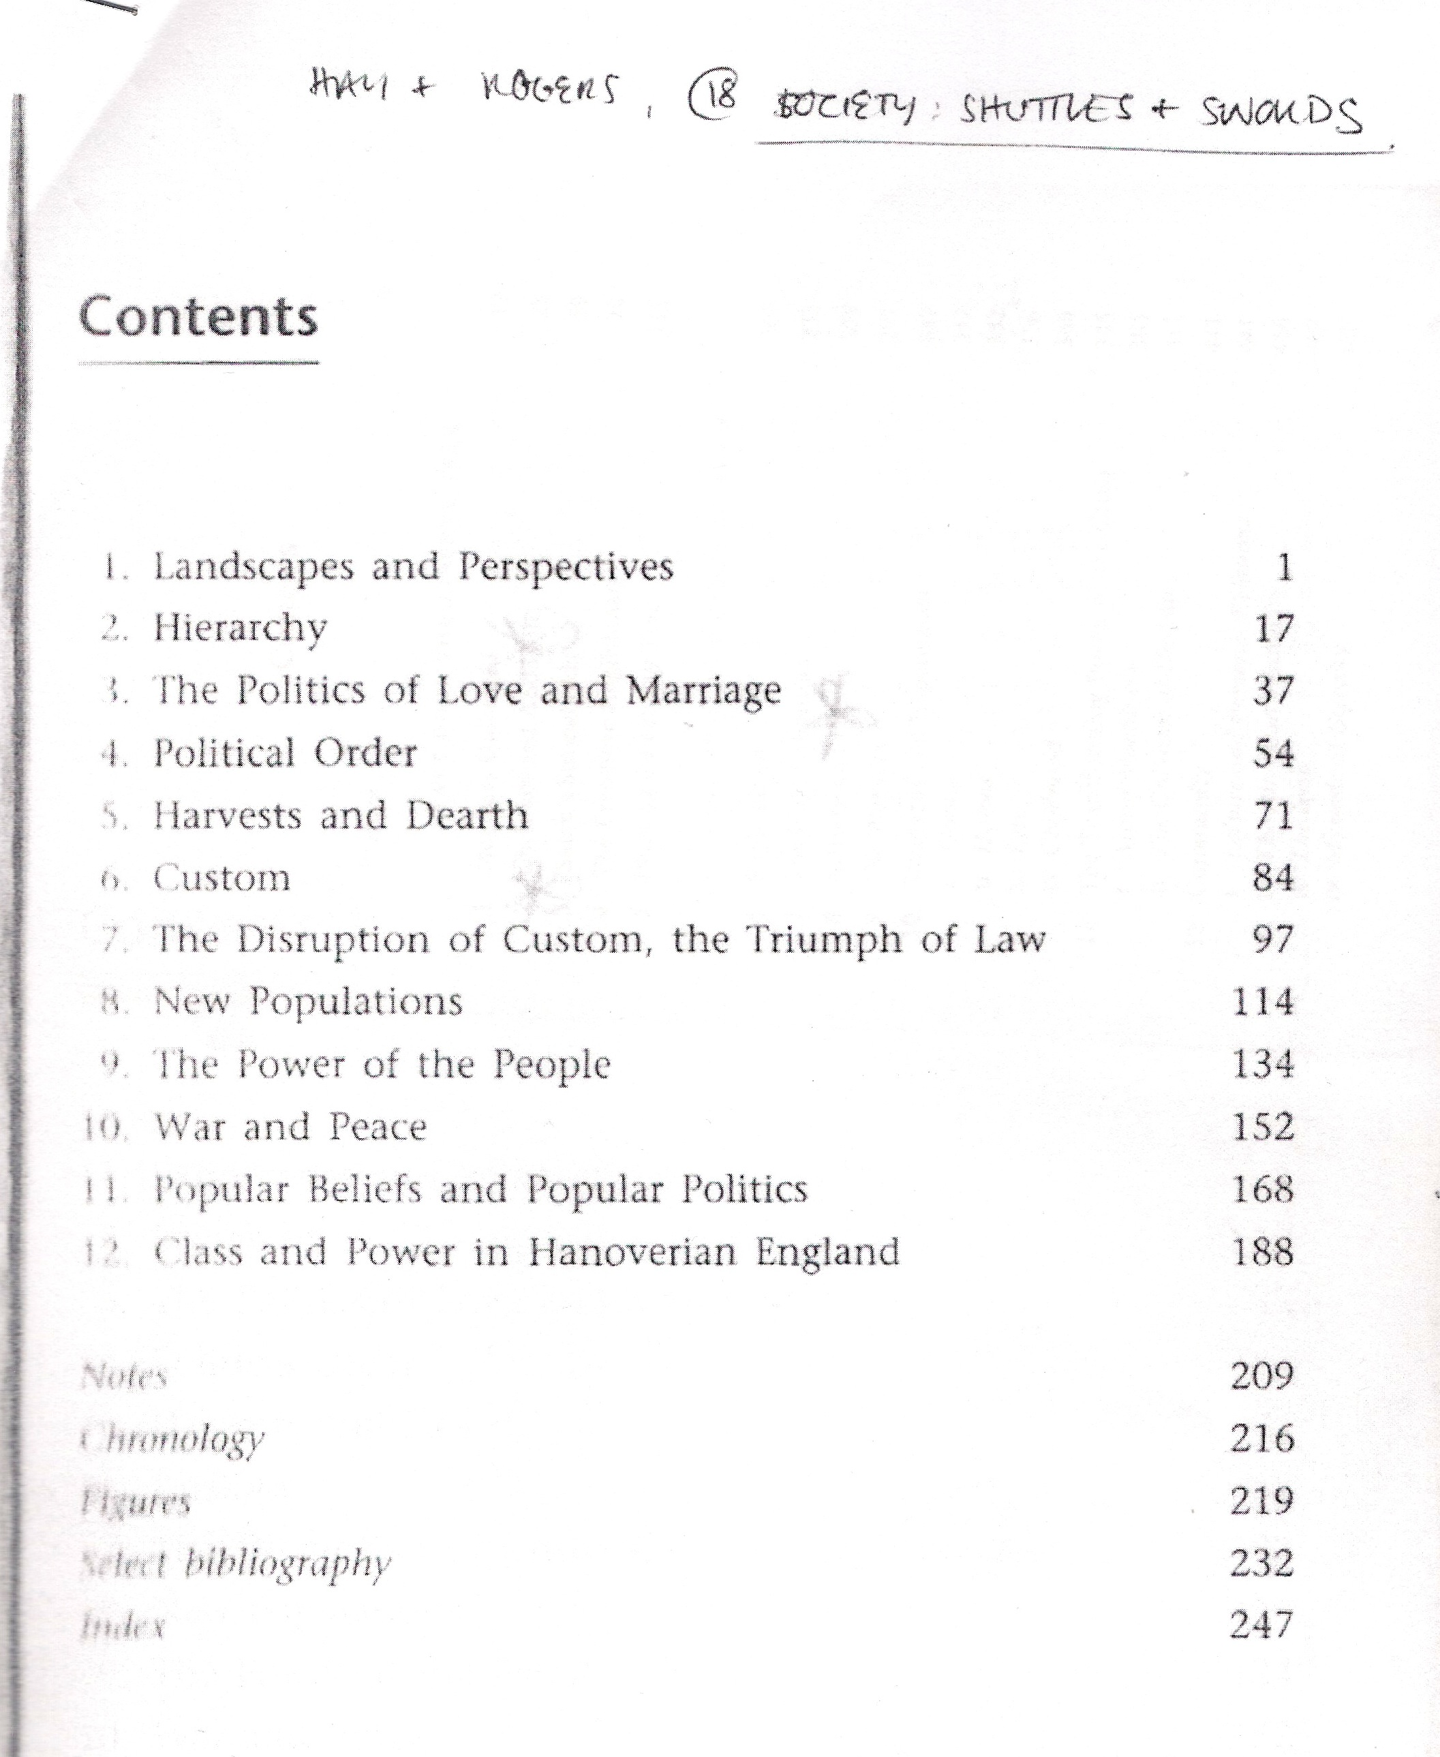
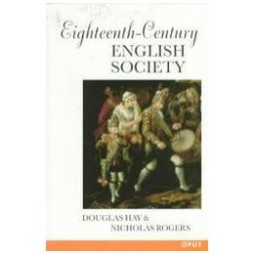
Douglas Hay and Nicholas Rogers: Eighteenth Century Society: Shuttles and Swords (Oxford, 1997)

Slide 15
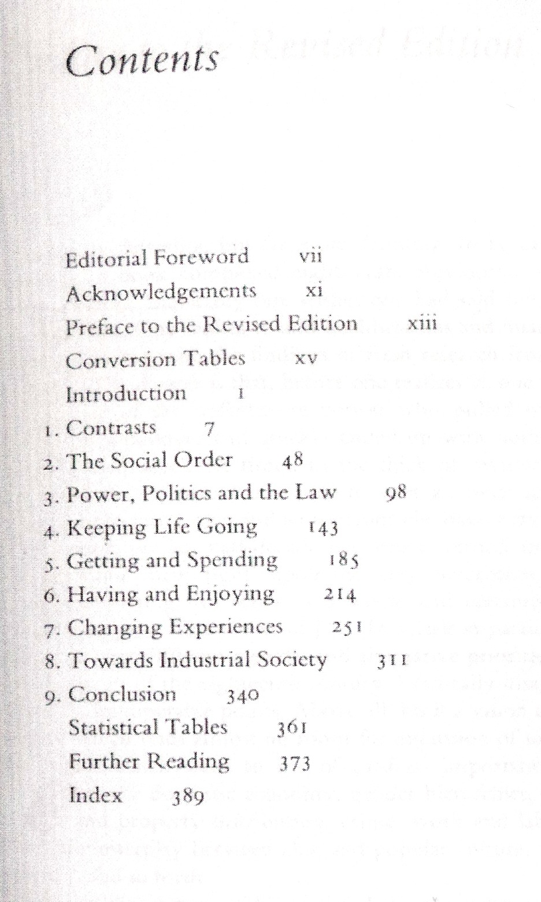
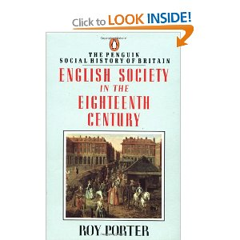
Roy Porter, English Society in the Eighteenth Century (Harmondsworth, 2001)

